Slide 1

Predictive Analytics in Business (BUAN 448)
K-Nearest-Neighbor (KNN)
(Chapter 7)
BUAN 488 – Fall 2022 – Dr. Davoodi

Slide 2
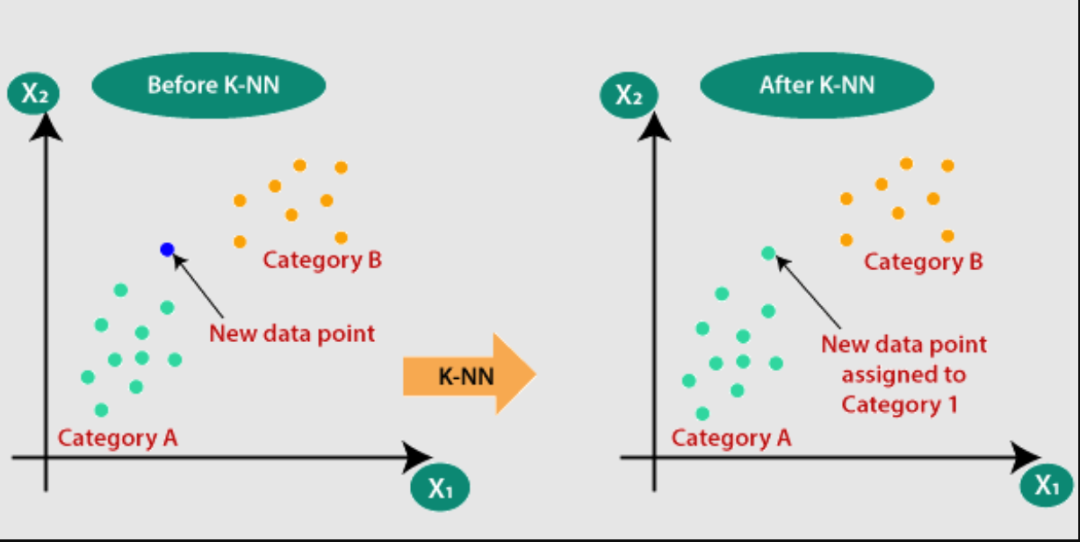
What is KNN?
Source: https://morioh.com/p/347a9262da98

Slide 3
What is KNN?
K-nearest-neighbors algorithm can be used for classification (of categorical outcome) or prediction (of a numerical outcome)
The method relies on finding “similar” records in the training data
These “neighbors” are then used to derive a classification or prediction for the new record by voting (for classification) or averaging (for prediction)

Slide 4
Characteristics
Data-driven, not model-driven
Makes no assumptions about the form of the relationship between the class membership (Y) and the predictors X1, X2, X3, …, Xp
This is a nonparametric method
Mathematical inference method that does not consider the underlying assumptions on the shape of the probability distribution of the population.

Slide 5
Basic Idea
For a given record to be classified, identify nearby records
“Near” means records with similar predictor values X₁, X₂, … X_{p}
Classify the record as whatever the predominant class is among the nearby records (the “neighbors”)

Slide 6
How to measure “nearby”?
The most popular distance measure is Euclidean distance
The Euclidean distance between two records (x1, x2,…, xp) and (u1, u2, …, up) is:
Typically, predictor variables are first normalized (= standardized) to put them on comparable scales
Use preProcess() from caret package to normalize
Otherwise, metrics with large scales dominate

Slide 7
Euclidean distance
In most cases, predictors should first be standardized before computing a Euclidian distance
The mean and standard deviation used to standardize new records are those of the training data, and the new record is not included in calculating them

Slide 8
K-NN for Classification

Slide 9
Classification Rule
After computing the distances between the record to be classified and existing records:
The simplest case: k =1 (look for the record that is the closest/the nearest neighbor), and classify the new record as belonging to the same class as its closest neighbor

Slide 10
Classification Rule
1. Find the nearest k neighbors to the records to be classified
2. Use a majority decision rule to classify the record, where the record is classified as a member of the majority class of the k neighbors

Slide 11
Example: Riding Mowers
Data: 24 households classified as owning or not owning riding mowers
Predictors: Income, Lot Size

Slide 13
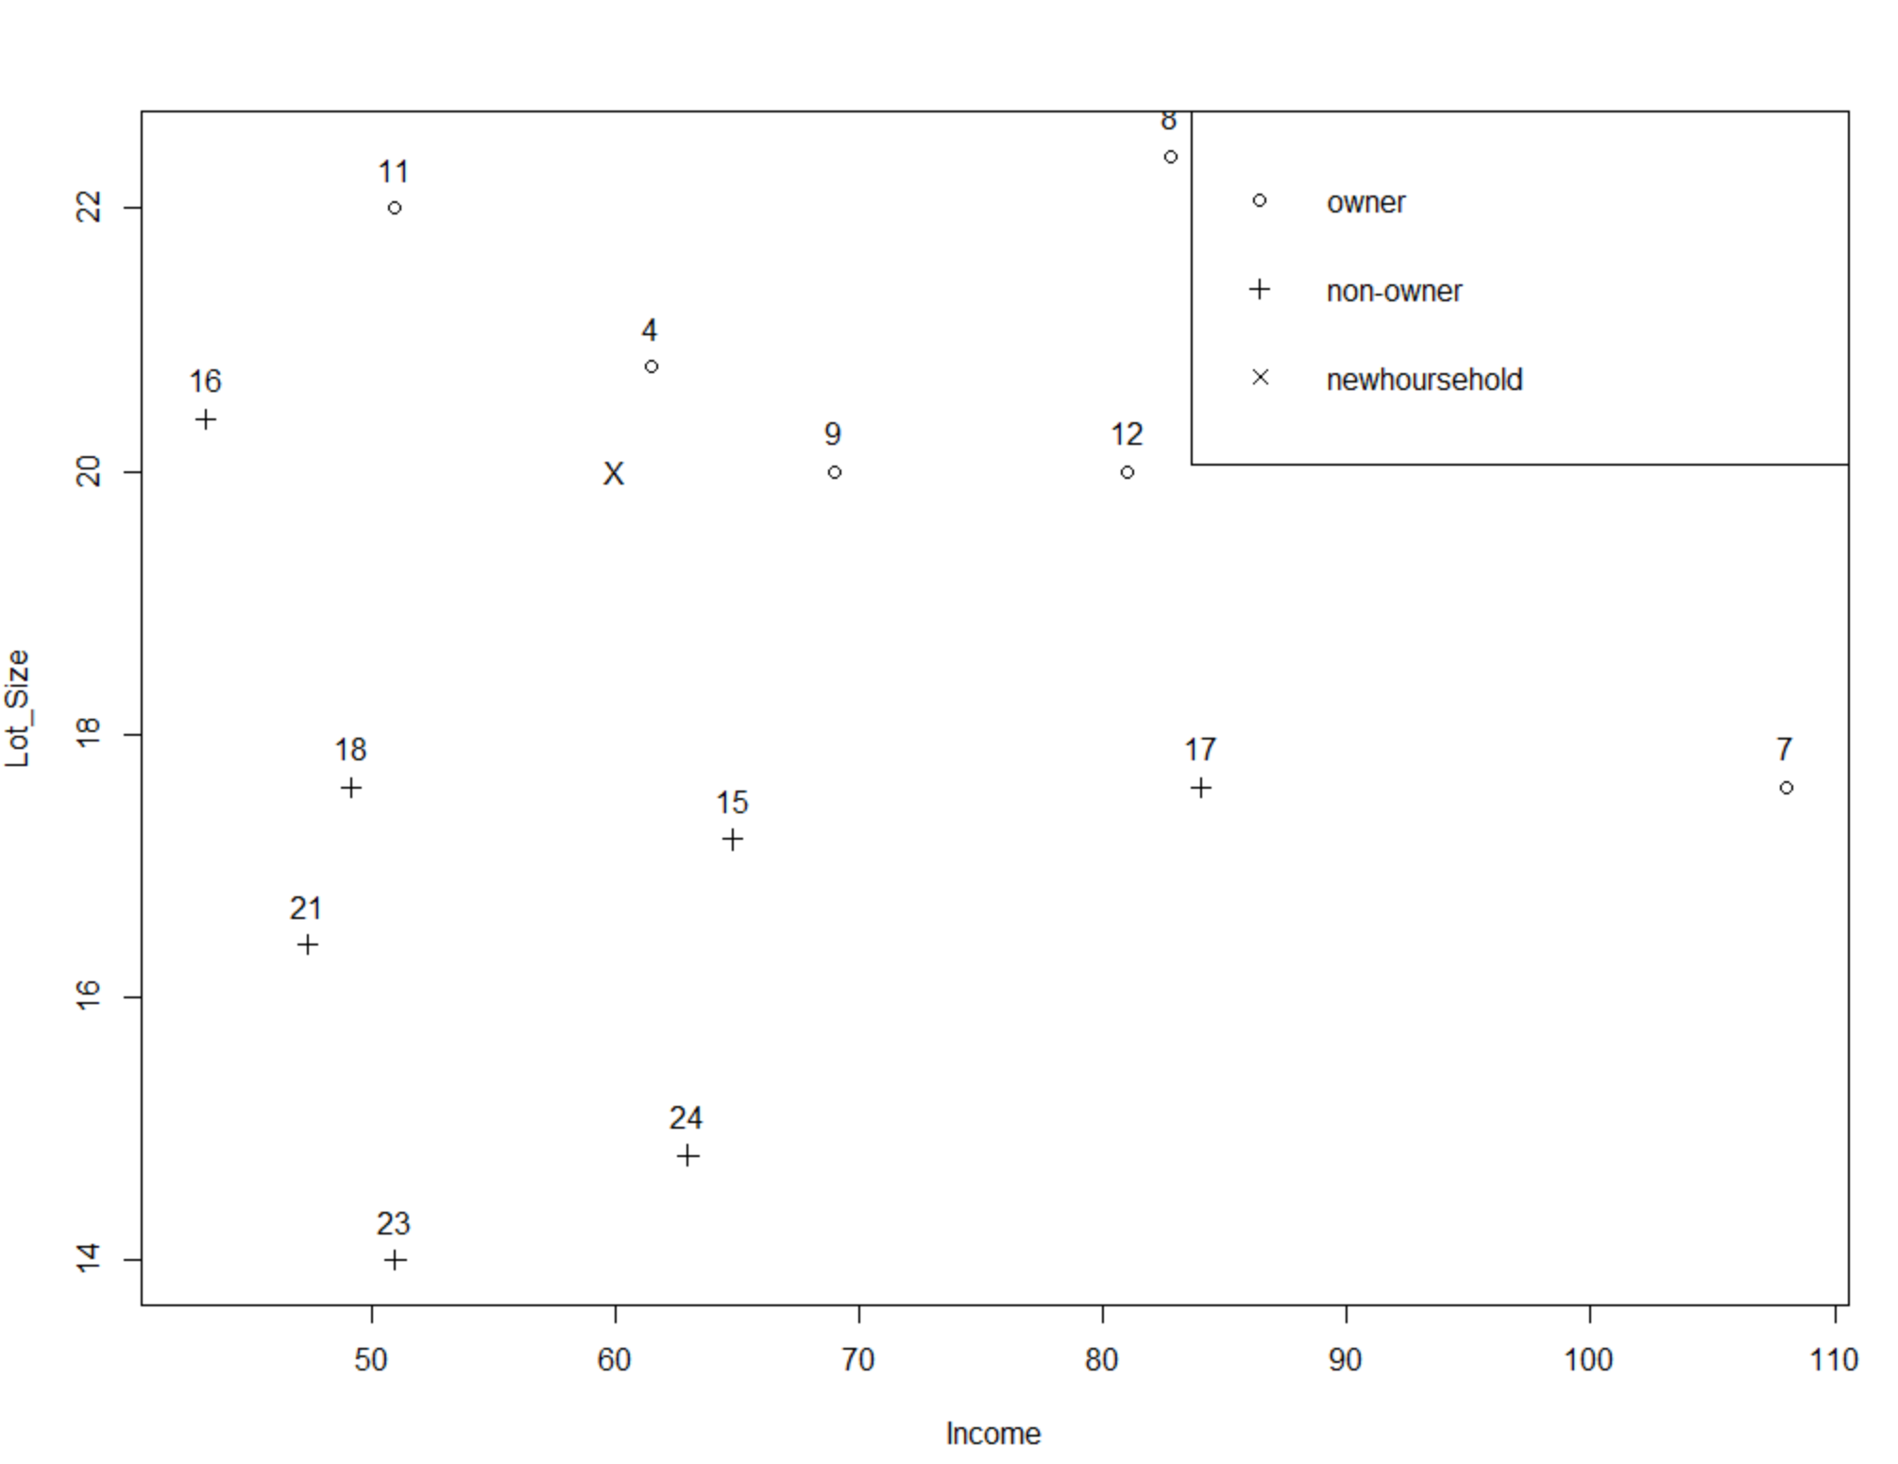
A new household with $60,000 income and lot size 20,000 ft^2
If K = 1, the closest to the new household is household #4
If K = 3, the closest to the new household are household #4, #9, #15
(majority vote: owner)

Slide 14
Choosing k
K is the number of nearby neighbors to be used to classify the new record
K=1 means use the single nearest record
K=5 means use the 5 nearest records
Typically choose that value of k which has lowest error rate in validation data

Slide 15
Low k vs. High k
Low values of k (1, 3, …) capture local structure in data (but also noise)
High values of k provide more smoothing, less noise, but may miss local structure
Note: the extreme case of k = n (i.e., the entire data set) is the same as the “naïve rule” (classify all records according to majority class)

Slide 16
Optimize KNN
For each record in validation data KNN finds neighbors amongst training data
The record is scored for all k.
Find the best k.
When multiple k’s have the lowest error rate, choose the lowest k.

Slide 17
K-NN for Prediction (for Numerical Outcome)

Slide 18
Using K-NN for Prediction (for Numerical Outcome)
Instead of “majority vote determines class” use average of response values
May be a weighted average, weight decreasing with distance

Slide 19
Advantages
Simple
No assumptions required about Normal distribution, etc.
Effective at capturing complex interactions among variables without having to define a statistical model

Slide 20
Shortcomings
Required size of training set increases exponentially with # of predictors, p
This is because expected distance to nearest neighbor increases with p (with large vector of predictors, all records end up “far away” from each other)
In a large training set, it takes a long time to find distances to all the neighbors and then identify the nearest one(s)
These constitute “curse of dimensionality”

Slide 21
Summary
Find distance between record-to-be-classified and all other records
Select k-nearest records
Classify it according to majority vote of nearest neighbors
Or, for prediction, take the as average of the nearest neighbors
“Curse of dimensionality” – need to limit # of predictors

